Slide 1
Simple Scheduler Update
Jason Santana, Matthew Pinneo, and Matthew Spitzley

Slide 2
Outline
Backend
List and History
Calendar and Settings
Changes
Completed
To do

Slide 3
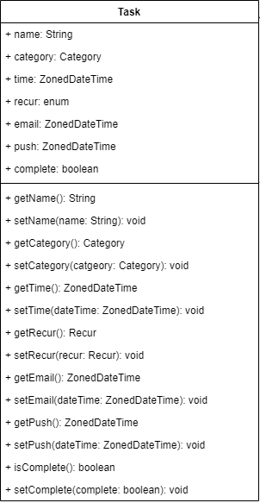
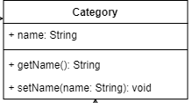
Task and Category Changes
Removal of old “TaskList” and “CategoryList” classes
Added task_list.xml file for the add a task button
“Recur” field now an enum

Slide 4
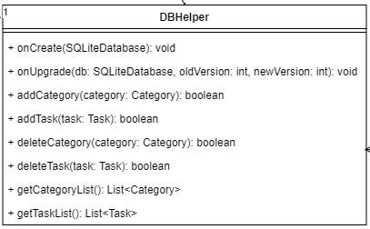
Database
Removal of old “database” class
Added “DBHelper”

Slide 5
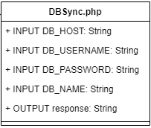
Database: To Do
Create PHP script
MySQL Synchronization event

Slide 6
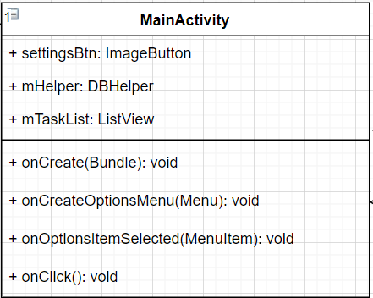
Main
Added fields for the settings button, database helper, and task list.
onCreateOptionsMenu to bring up the add a task box.
onOptionsItemSelected to respond to user interactions of “add” or “cancel”
onClick for the settings button

Slide 7
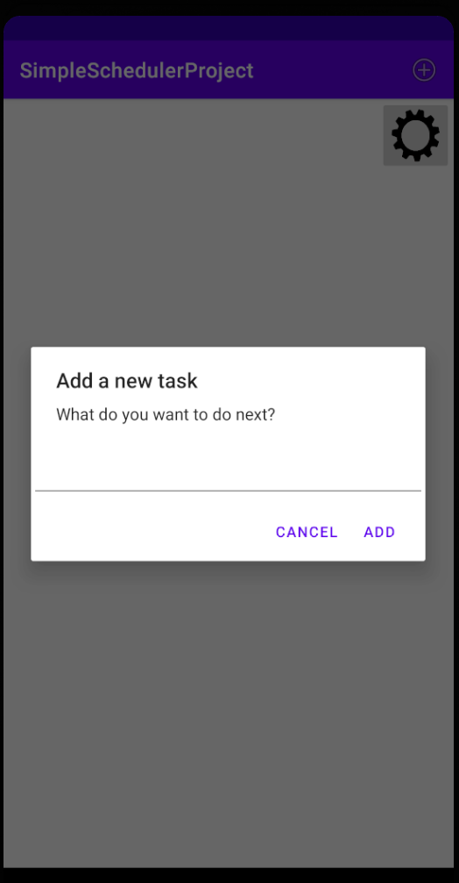
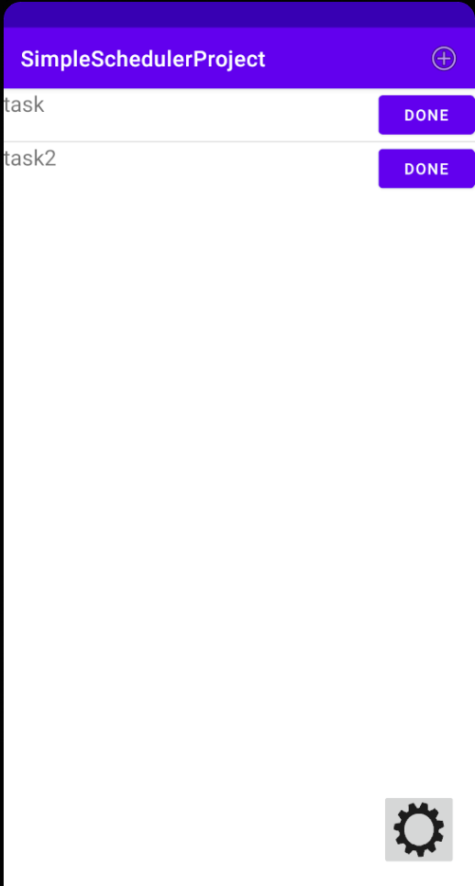
Main: To do
Add the remaining fields when adding tasks.
Add a method to update UI after adding a task.
Change button for completion to an interaction when selecting a task.

Slide 8
History
Completed:
Create activity on main page to show list of completed tasks.
To do:
Use an ArrayList filled with tasks set as complete to display history, similar to task list and category list.

Slide 9
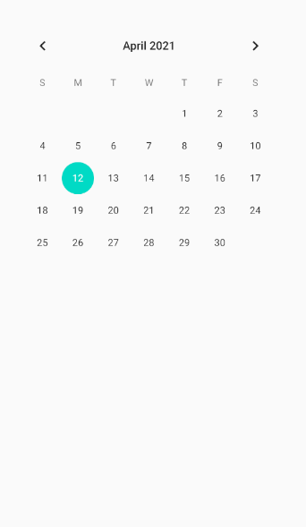
Calendar
Changes:
-When a date is selected, any tasks that fall under that day will be displayed in the area below the calendar.
To Do:
-Displaying the tasks under selected days.
-Adding an “Undated” button for tasks that were not given a specified date.
-Adding the category list drop down
-Adding the yearly view functionality

Slide 10
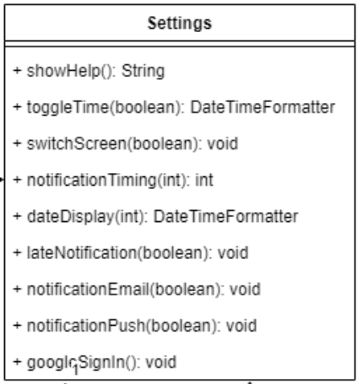
Settings
Changes:
-Some function parameters and return values have changed
-notificationType has been split into notificationEmail and notificationPush

Slide 11
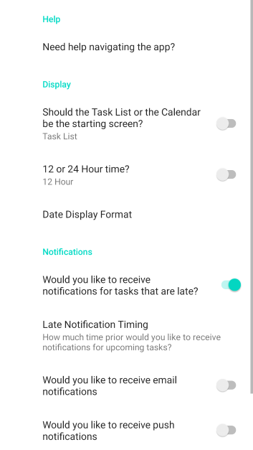
Settings
To Do:
-help, switchScreen, and googleSignIn are not yet implemented.

Slide 12
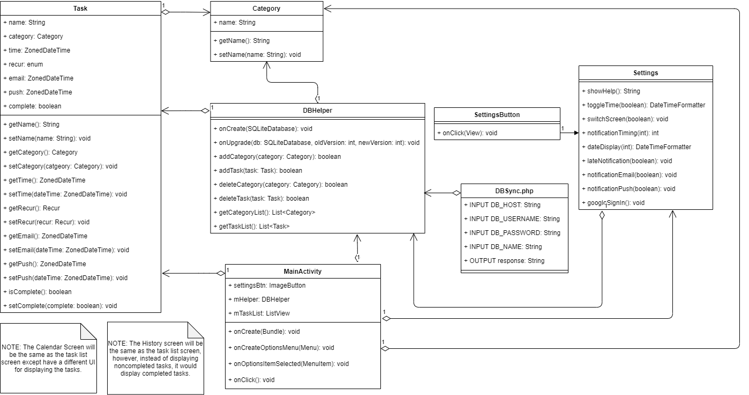
New Class Diagram

Slide 13
Summary
Database
DBHelper, PHP script, SQL sync
Calendar
Changes in layout, Yearly view
Settings
Notifications, Google Sign-in
Main
Methods for settings, history

Slide 14
Questions?

